Slide 1
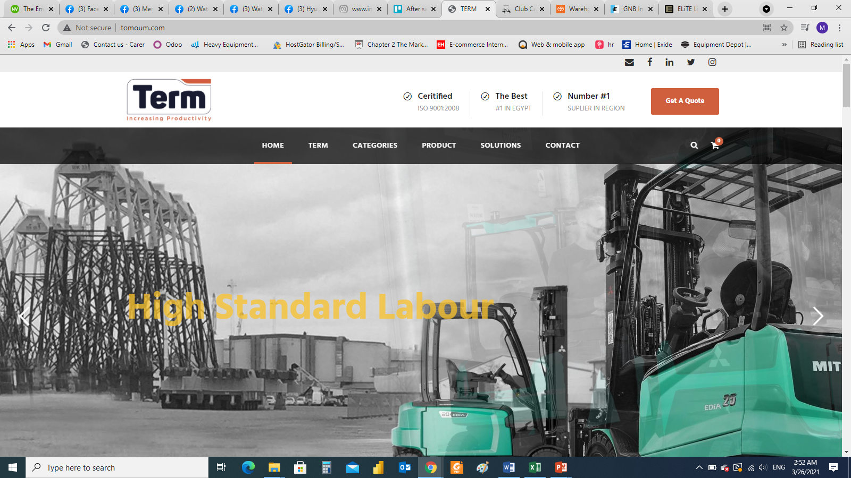
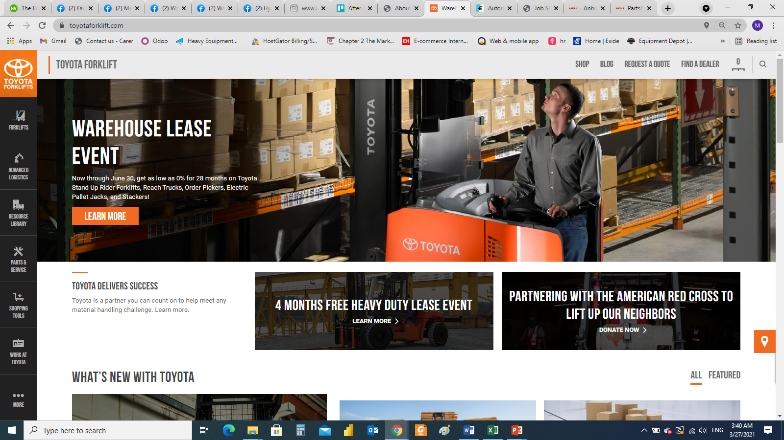
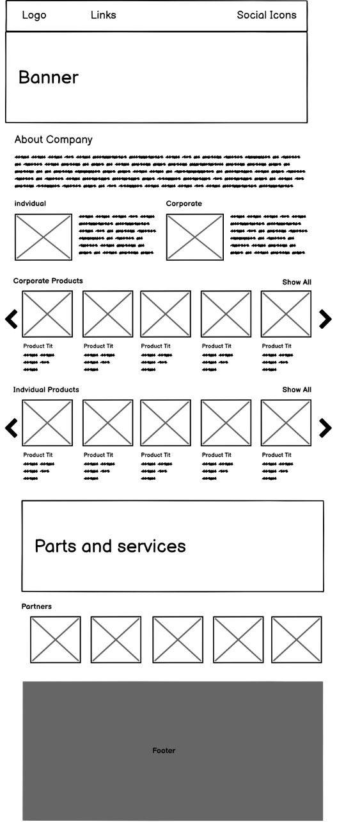
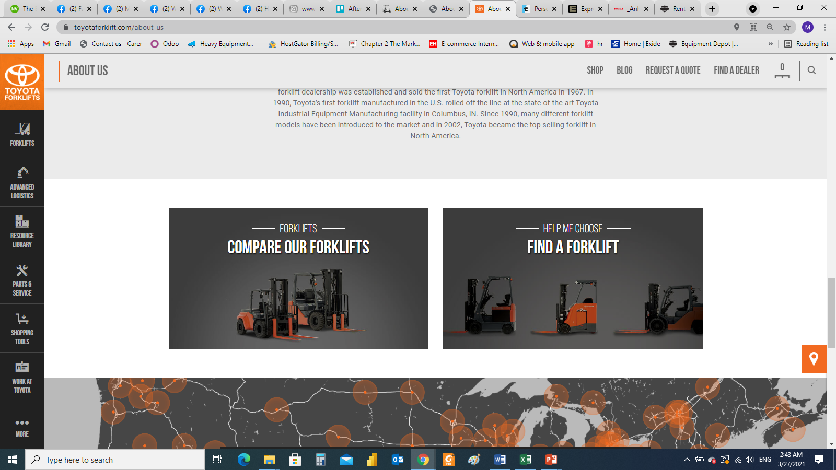
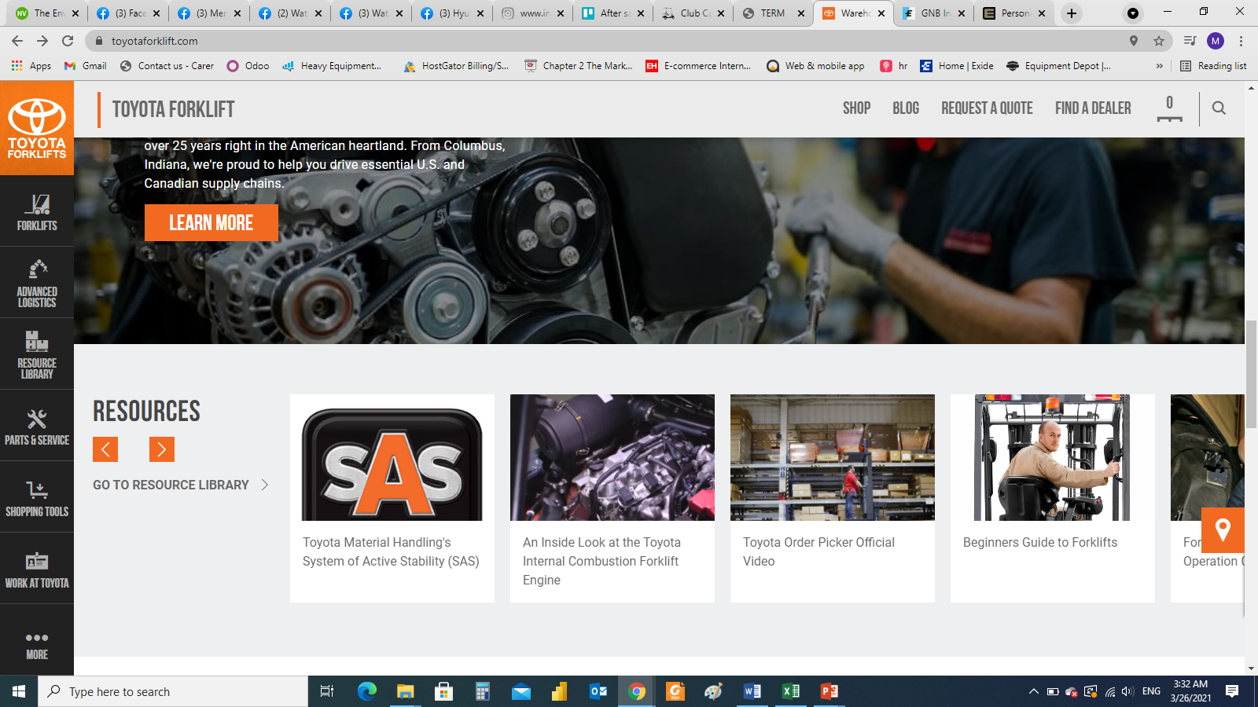


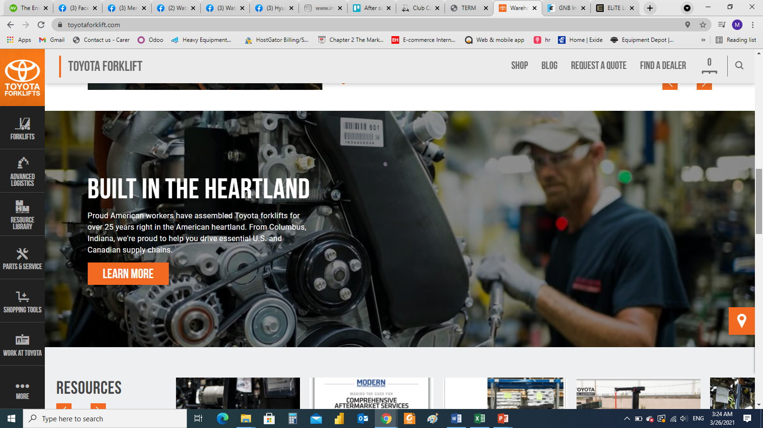
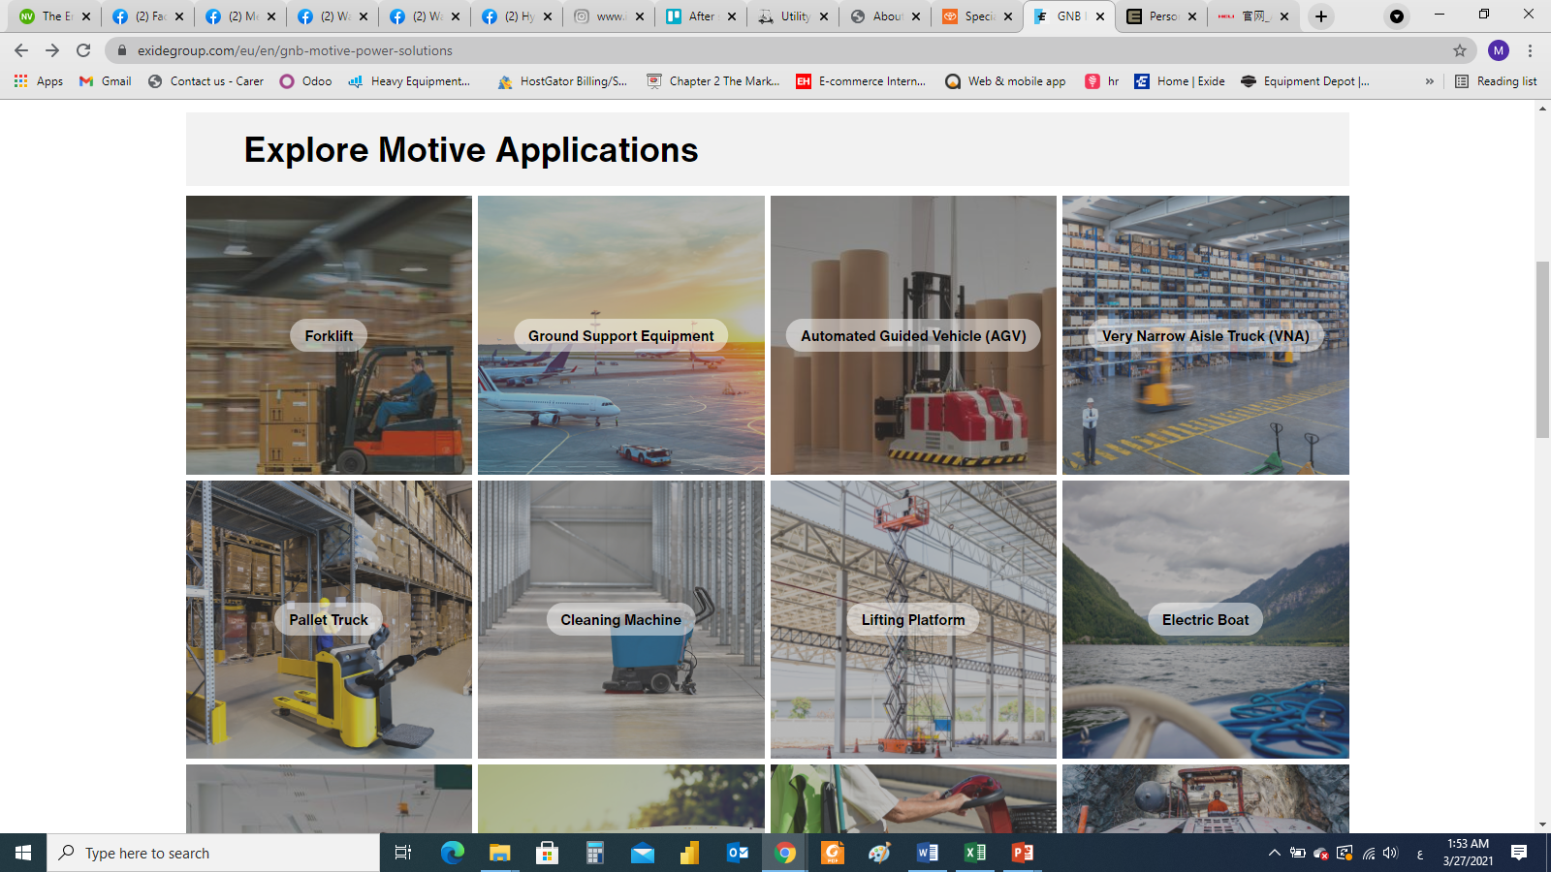
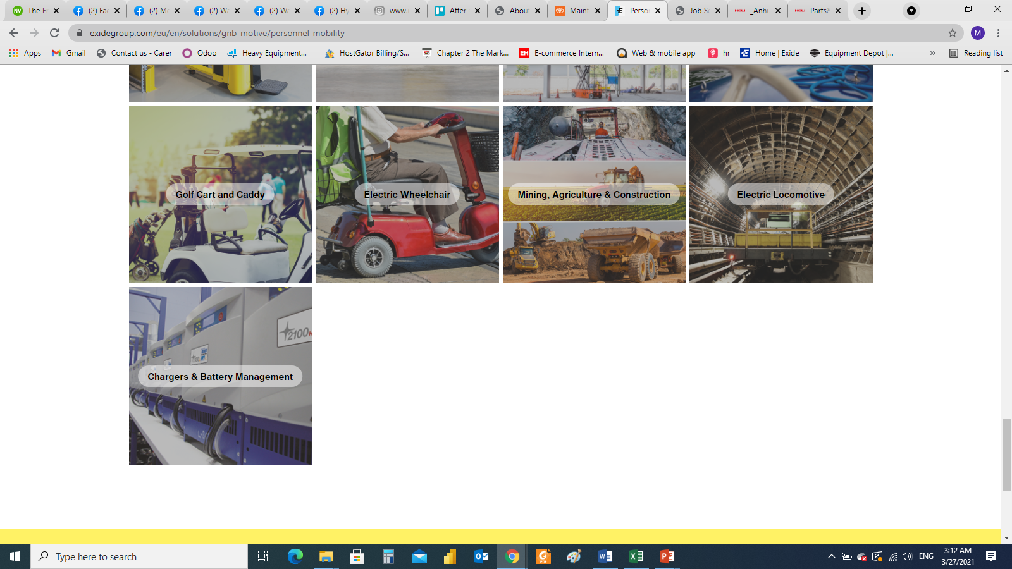
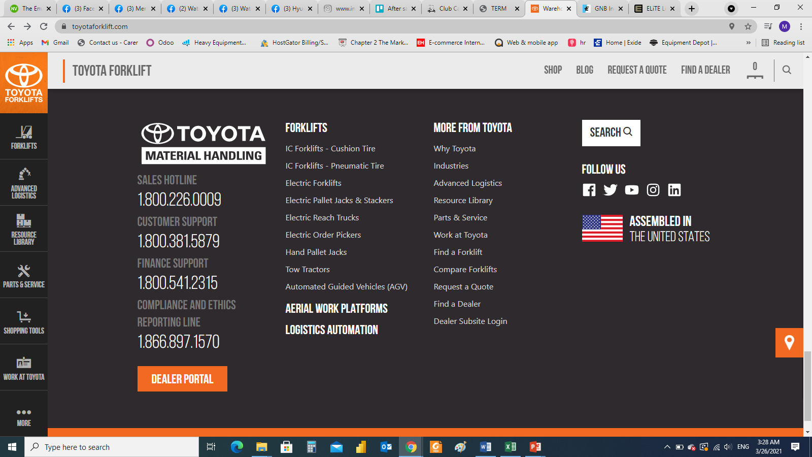
Home page
Delete white bar
Make logo in black bar
Make icons in black bar
Links:
About – Products (Machinery – Personal) - Parts and service - Contact
Fonts like Toyota home page fonts
Video and photo sliding
https://www.toyotaforklift.com/
Individual product line
Corporate product line
BRANDS
Parts and services
APPLICATIONS Corporate (FORKLIFT / GOLF CARTS / ATV …)
APPLICATIONS Individual (FORKLIFT / GOLF CARTS / ATV …)
Contacts
Notes:
Forklift and material handling (Mitsubishi – Heli – Noblelift)
Electric vehicles (Citycart)
Power sports (Buggy – Segway)

Slide 2
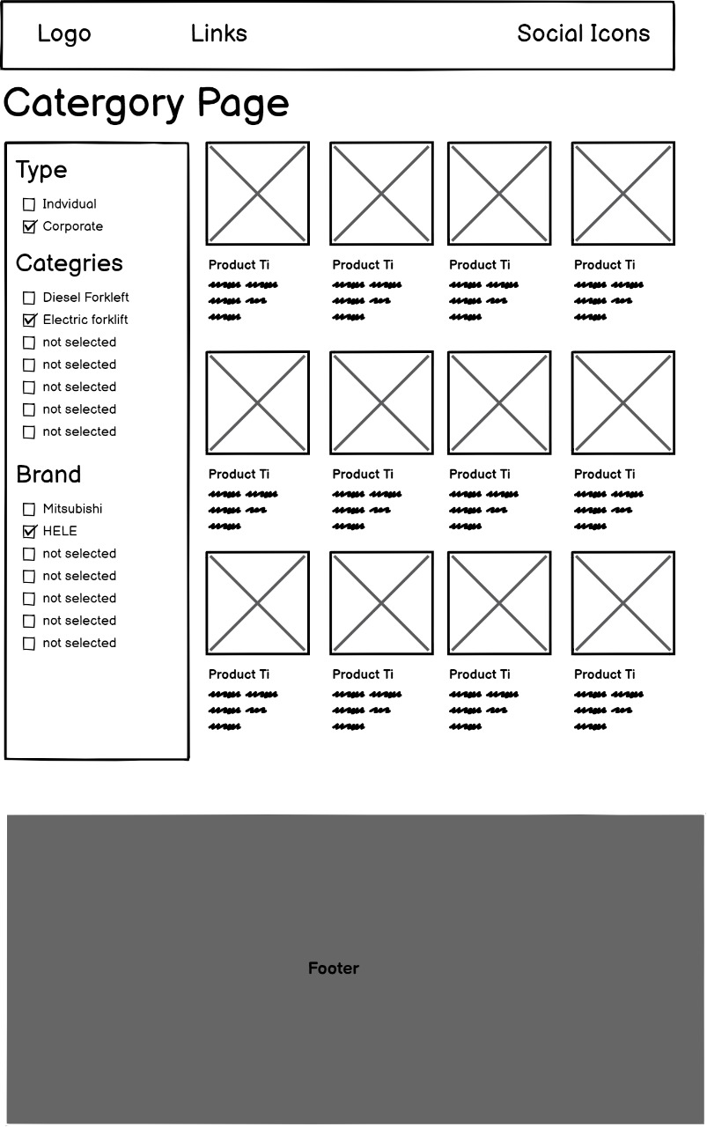
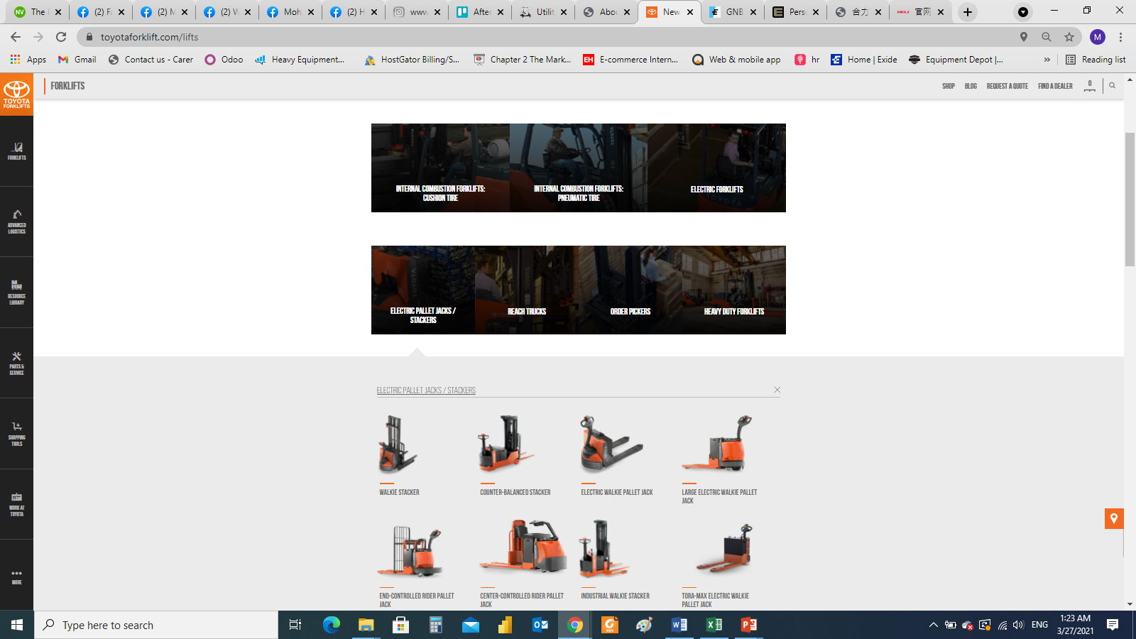
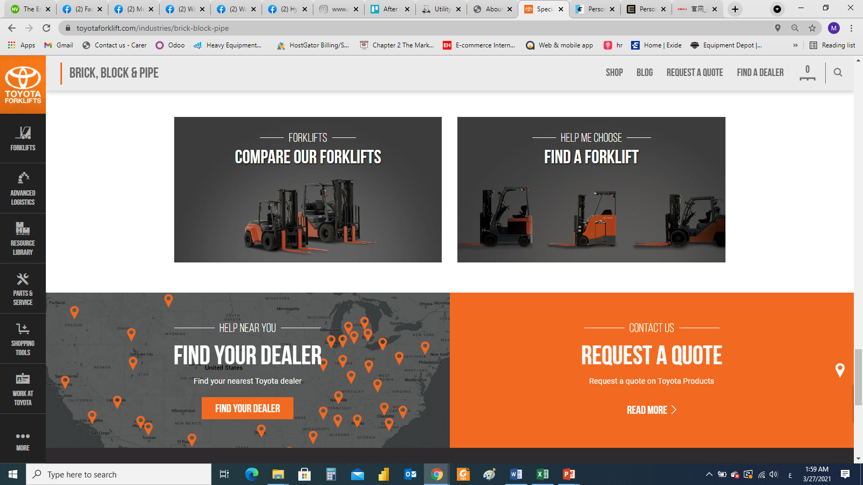
Products category page ( Corporate )
Create PAGE FOR Individual category and page cabaret for Corporate category
Notes:
Forklift and material handling (Mitsubishi – Heli – Noblelift)
Electric vehicles (Citycart)
Power sports (Buggy – Segway)

Slide 3
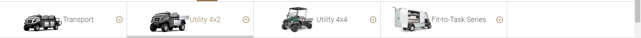
Products category page ( Corporate )
Photo and description
Corporate
Individual
Forklift (Category1)
Material handling (Category2)
Utility citycart (Category3)
Remark
عند الوقوف على كلمة Products يظهر اختيارين ( Corporate / Individual )
و عند الوقوف على corporate يظهر اختيارات لل category و بالظغط على الcategory ينتقل للصفحة الخاصة بال product category ليختار المنتج ( و الفيلتر يتم تعديله تلقائى بناءا على اختيار العميل )
Notes:
Forklift and material handling (Mitsubishi – Heli – Noblelift)
Electric vehicles (Citycart)
Power sports (Buggy – Segway)

Slide 4
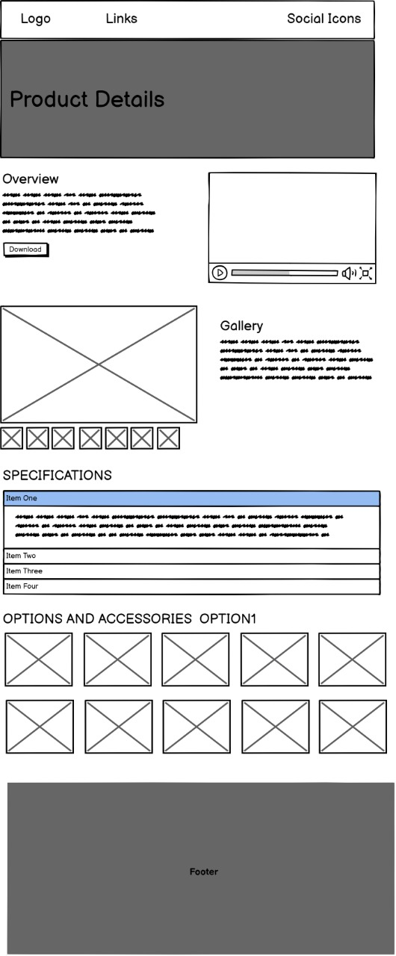
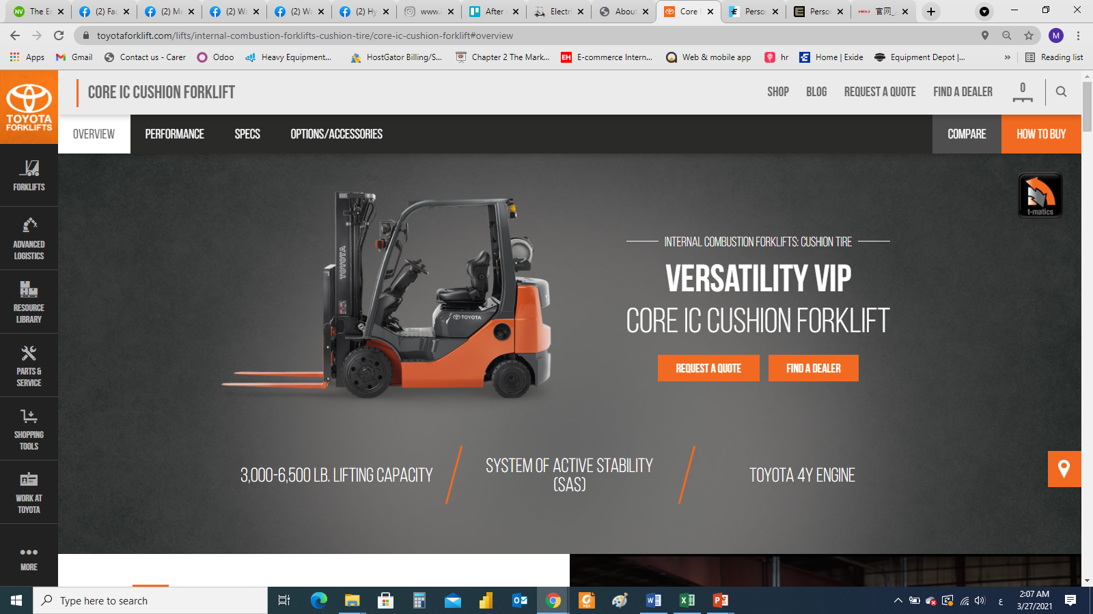
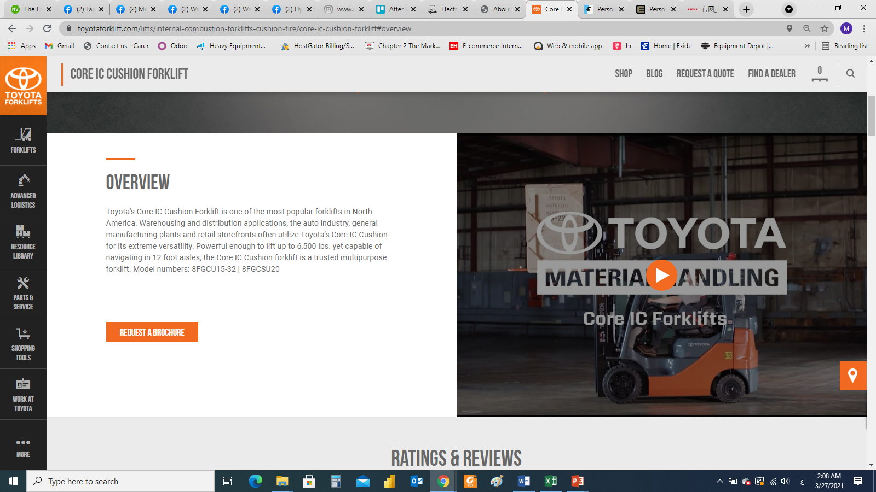
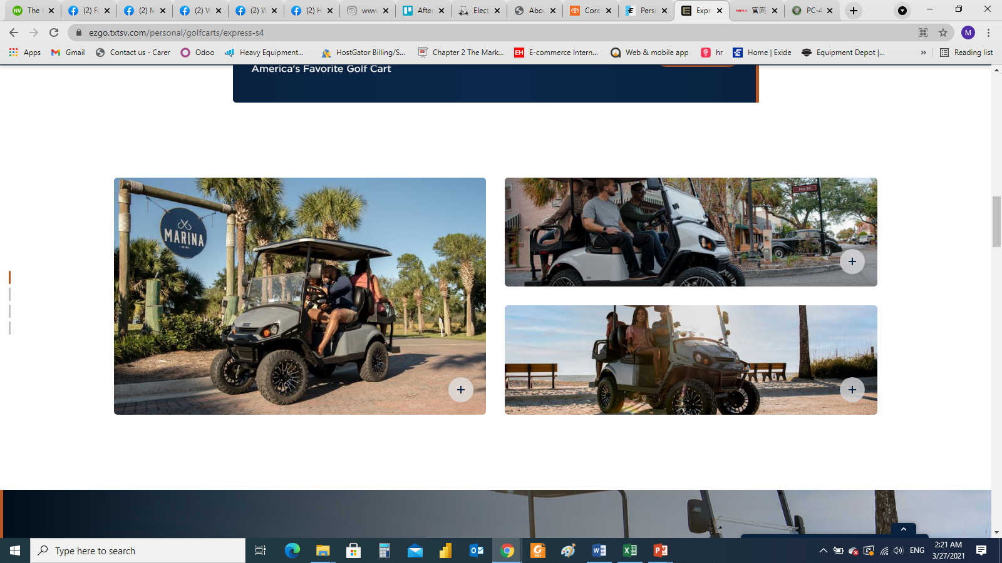
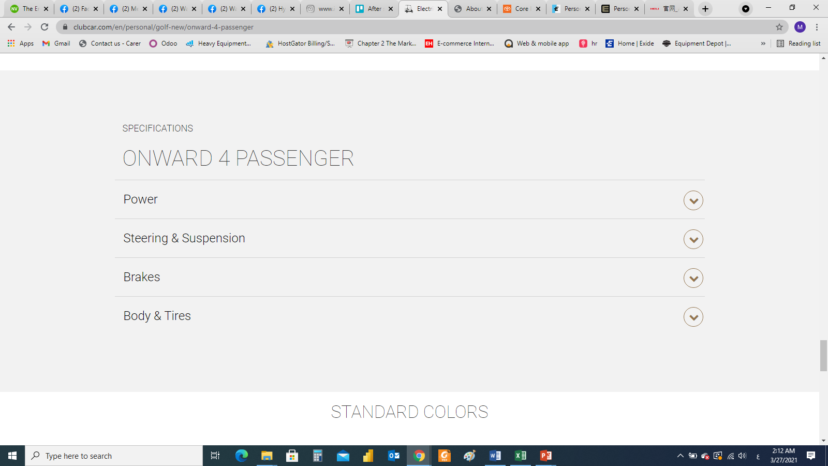
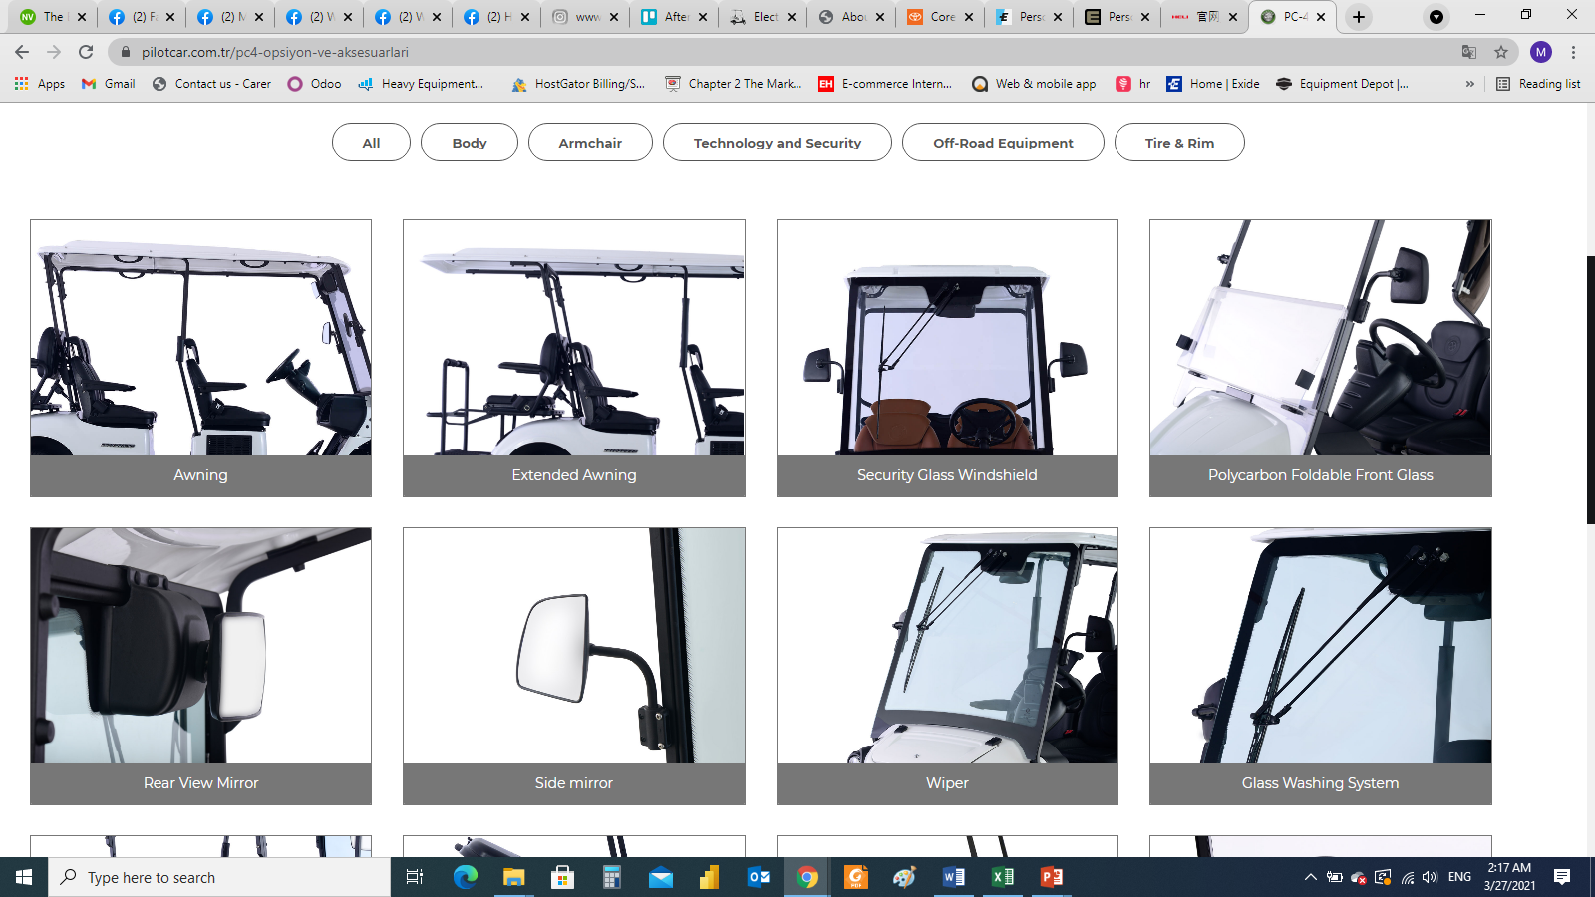
Products page
https://www.toyotaforklift.com/lifts
https://www.toyotaforklift.com/lifts/internal-combustion-forklifts-cushion-tire/core-ic-cushion-forklift#overview
OVERVIEW
Video
Download brochure PDF
Gallery
https://ezgo.txtsv.com/personal/golfcarts/express-s4
SPECIFICATIONS
https://www.clubcar.com/en/personal/golf-new/onward-4-passenger
https://ezgo.txtsv.com/personal/golfcarts/express-s4
OPTIONS AND ACCESSORIES
OPTION1
Notes:
Forklift and material handling (Mitsubishi – Heli – Noblelift)
Electric vehicles (Citycart)
Power sports (Buggy – Segway)

Slide 5
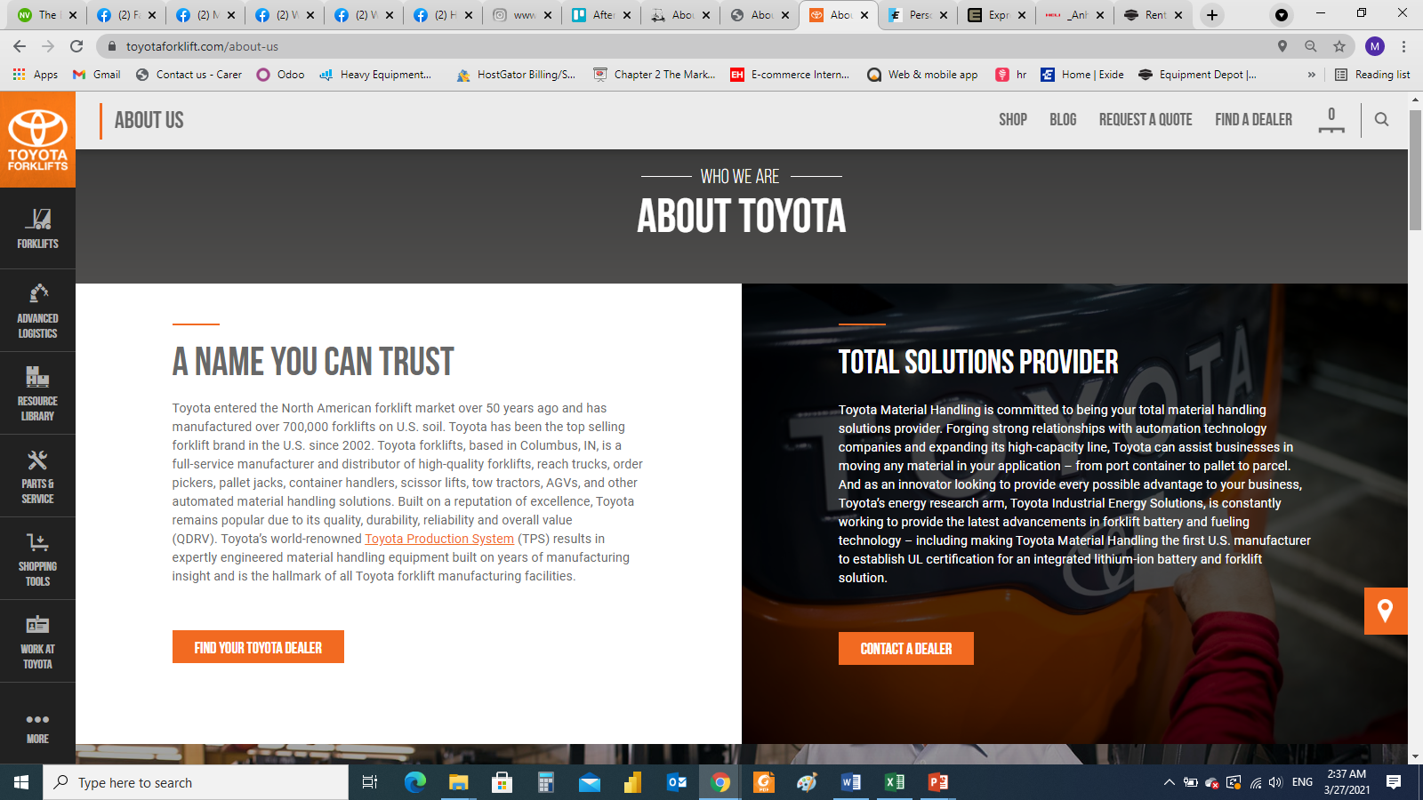
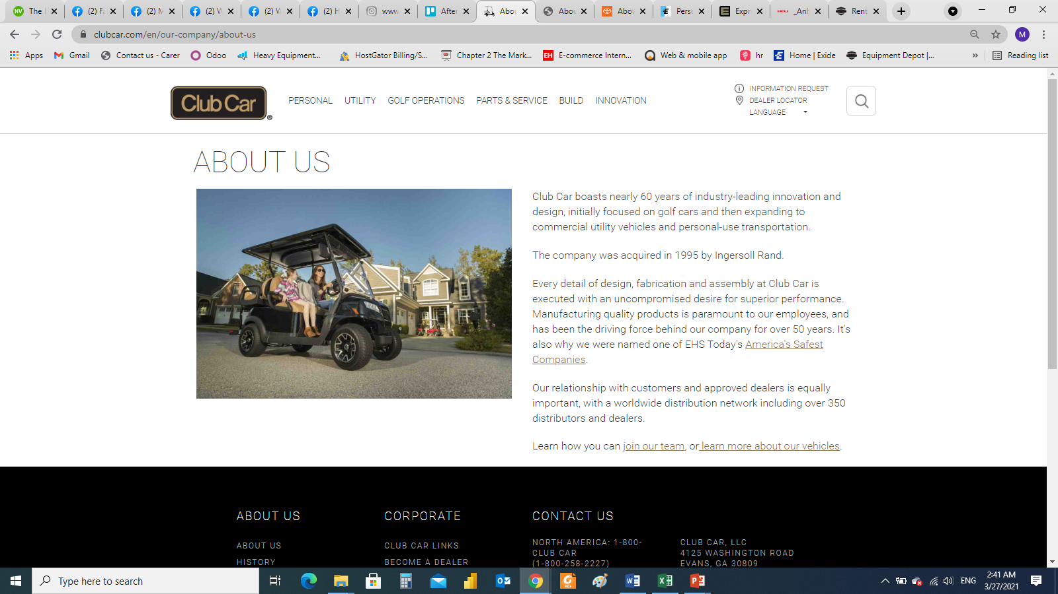
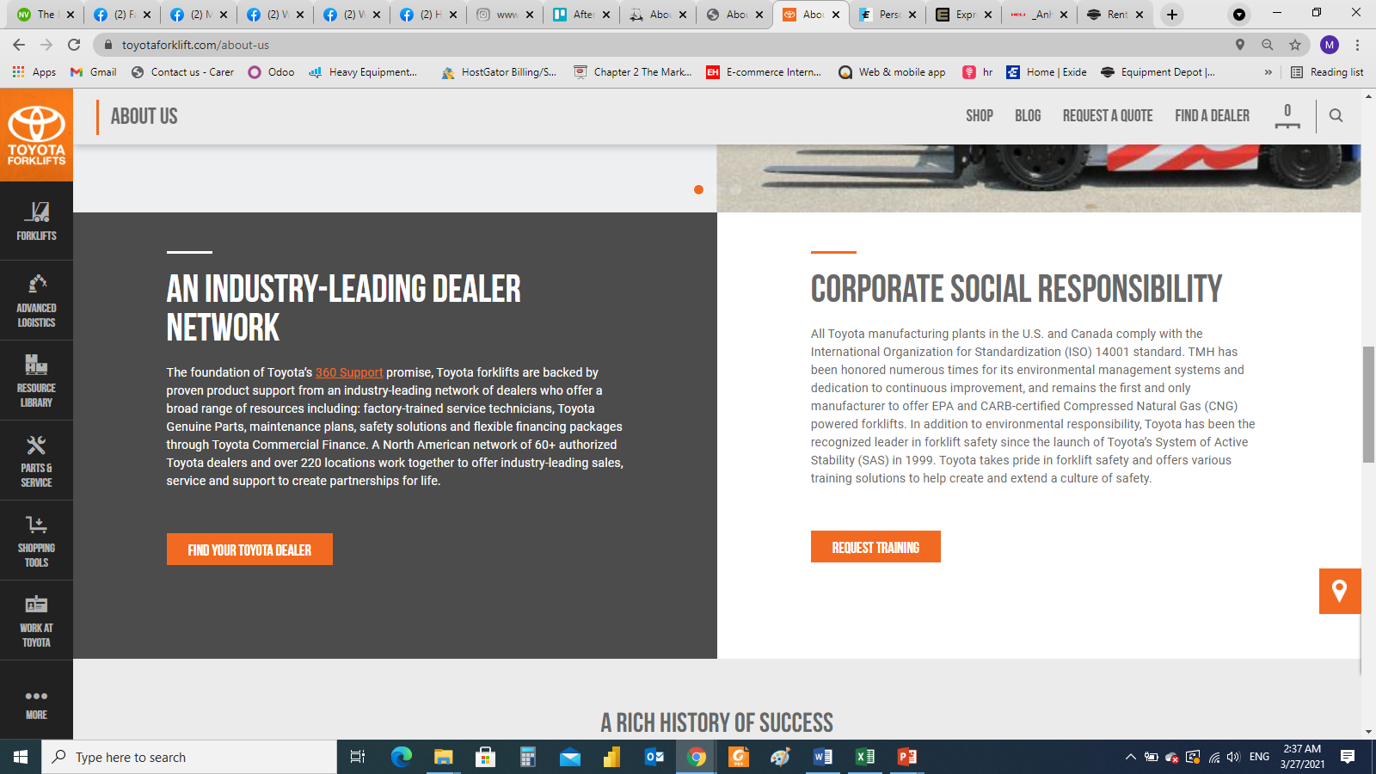
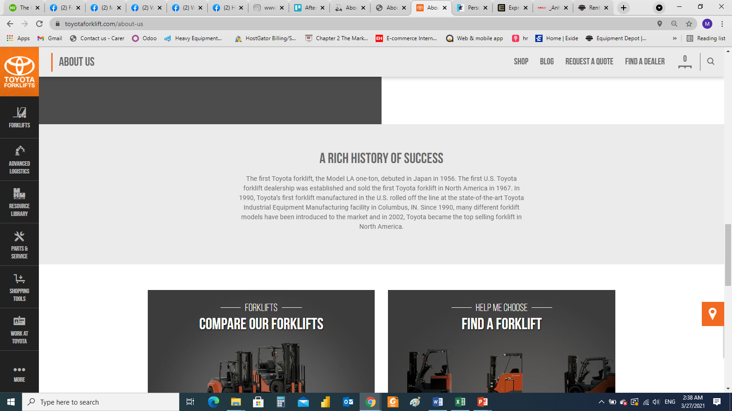
ABOUT
https://www.toyotaforklift.com/about-us
OUR PRODUCTS
Personal product line
Machinery product line
Notes:
Forklift and material handling (Mitsubishi – Heli – Noblelift)
Electric vehicles (Citycart)
Power sports (Buggy – Segway)

Slide 6
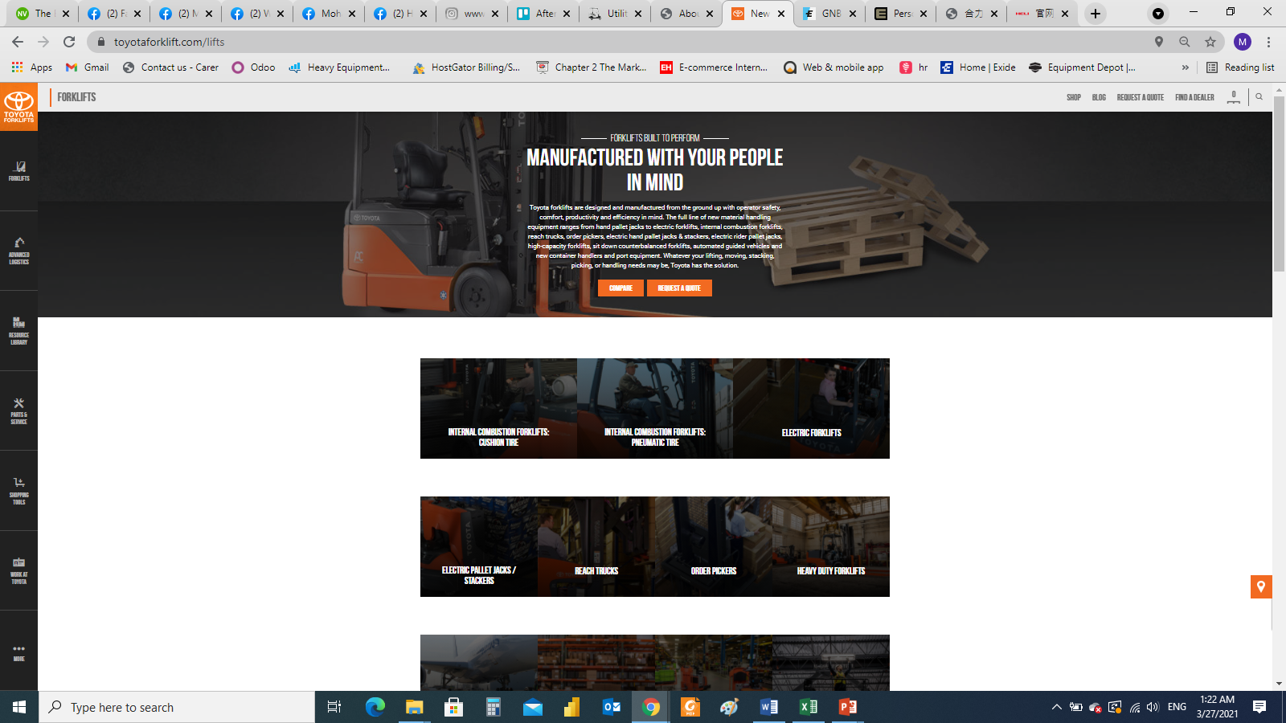
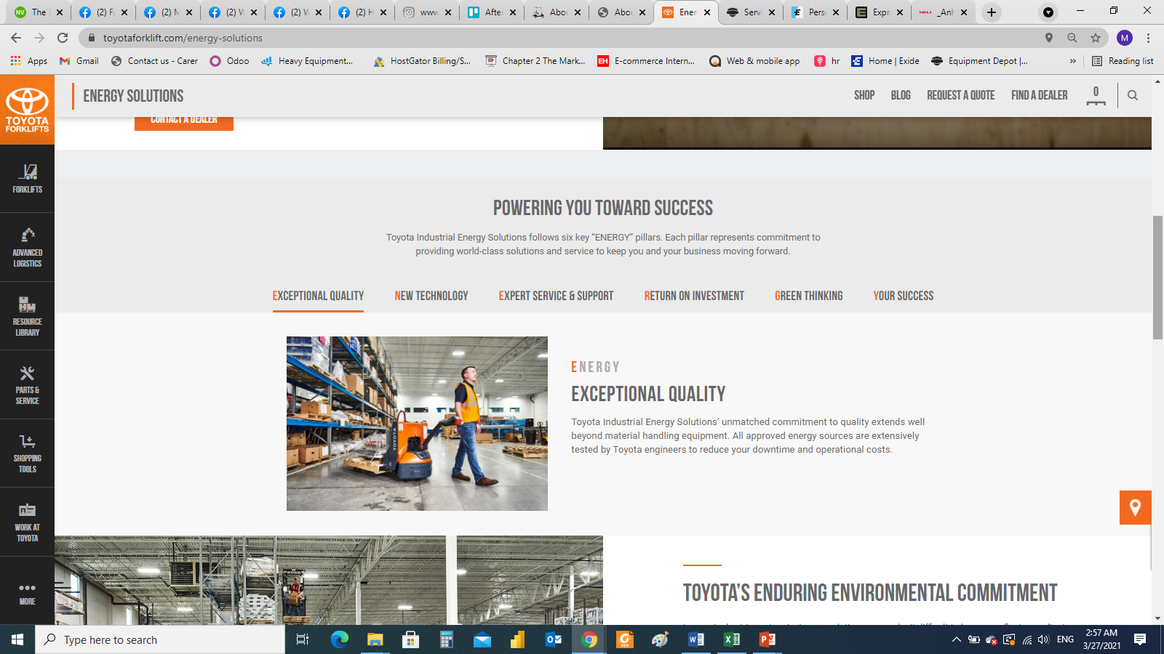
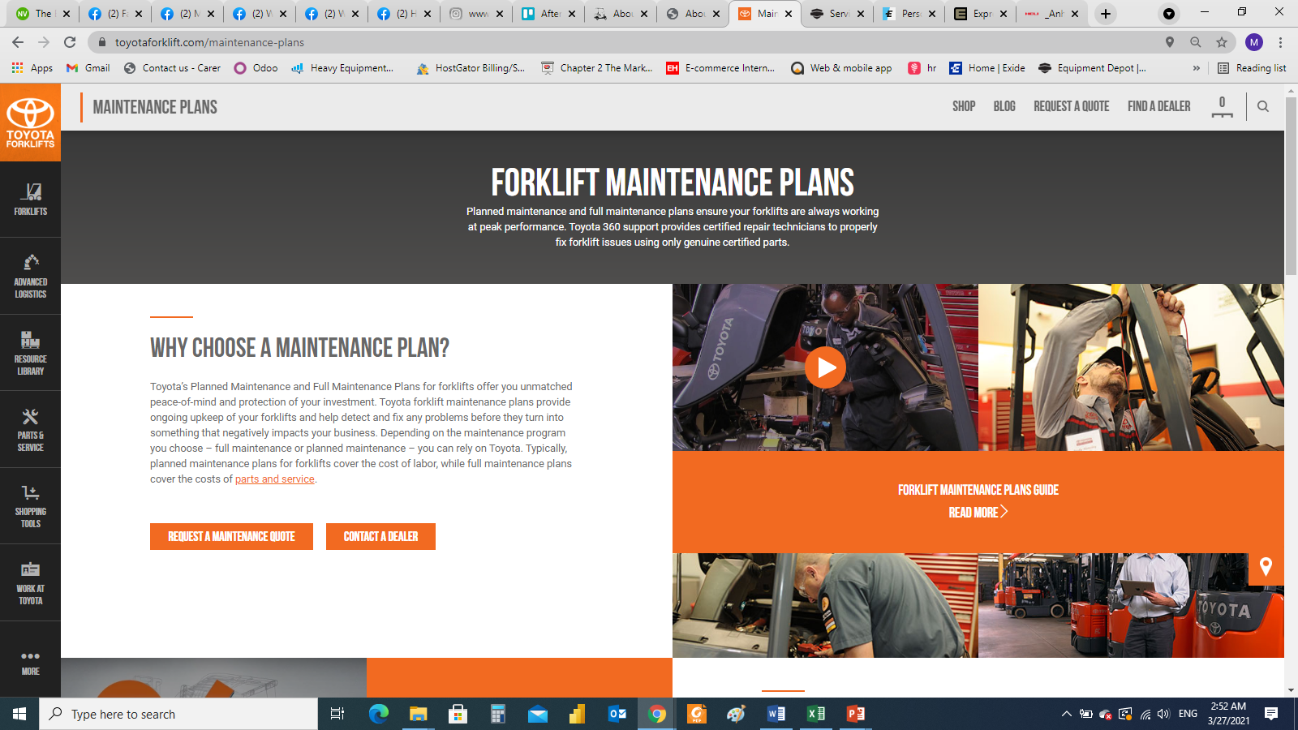
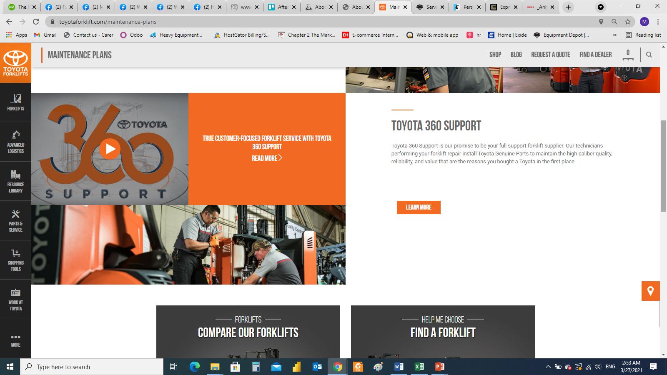
SERVICE
Request a consultation / Parts / Maintenance / other enquires
https://www.toyotaforklift.com/energy-solutions
https://www.toyotaforklift.com/maintenance-plans
Notes:
Forklift and material handling (Mitsubishi – Heli – Noblelift)
Electric vehicles (Citycart)
Power sports (Buggy – Segway)

Slide 7
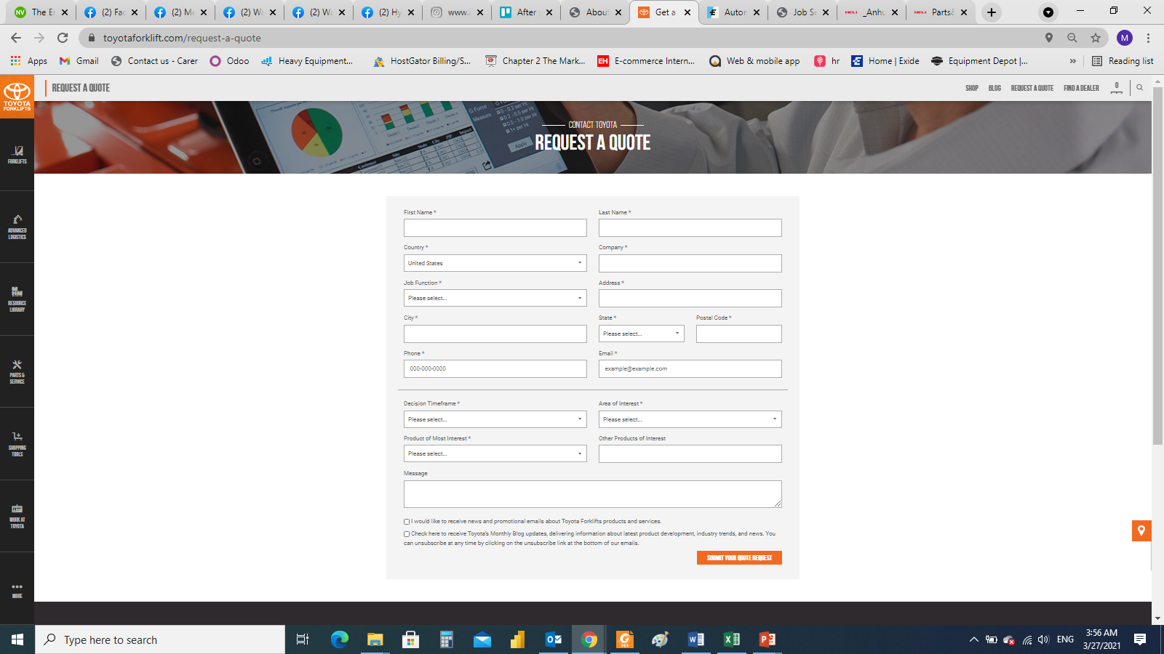
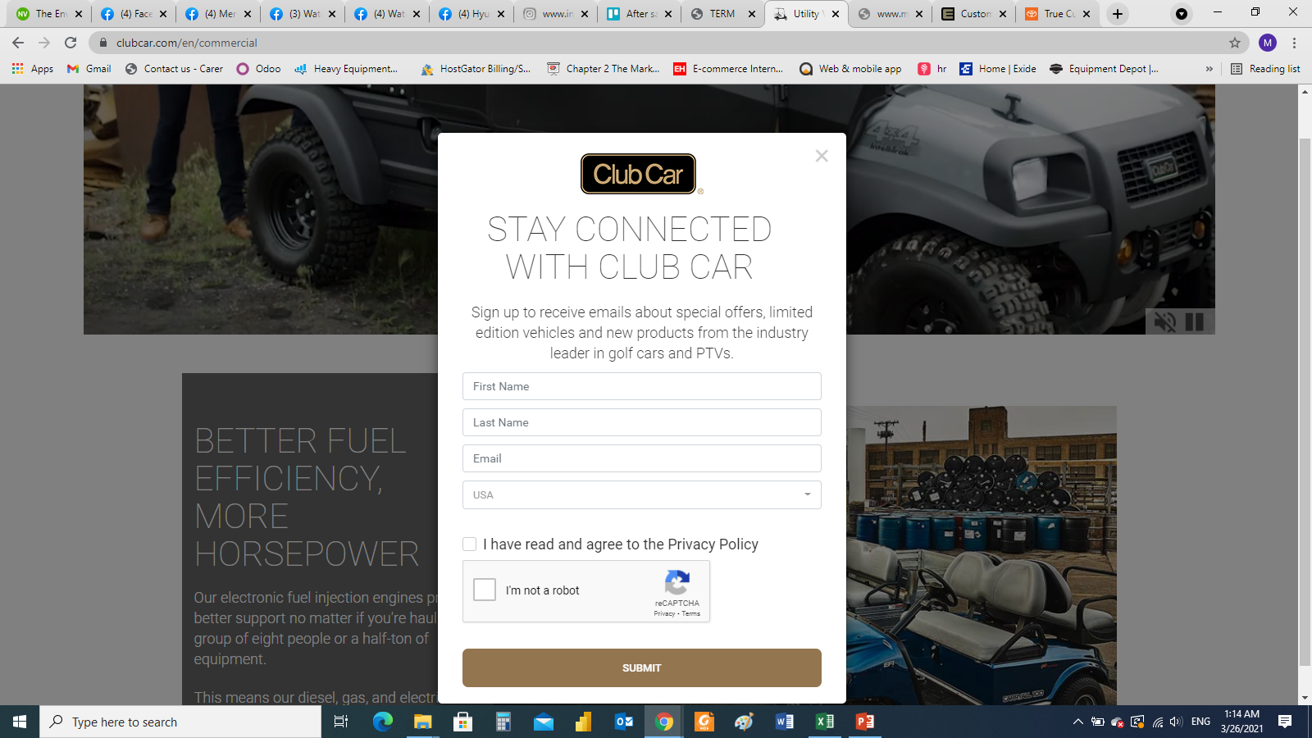
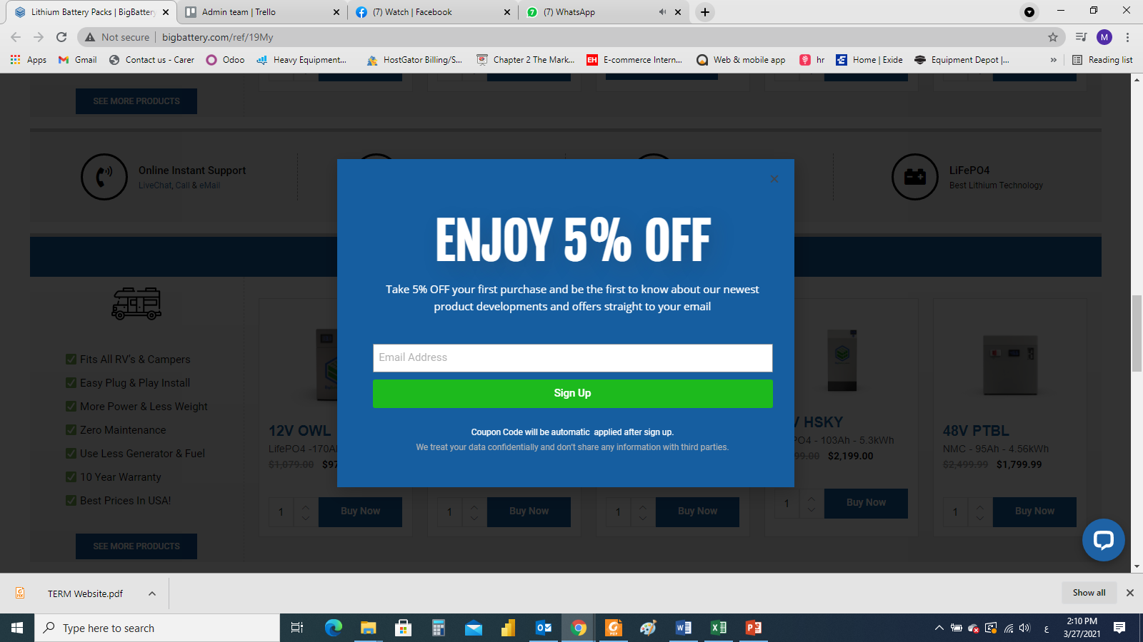
More pages on website
https://www.toyotaforklift.com/request-a-quote
Request a quotation
Add pop ups
Notes:
Forklift and material handling (Mitsubishi – Heli – Noblelift)
Electric vehicles (Citycart)
Power sports (Buggy – Segway)

